Slide 1
Physics of Longboard Downhill / Freeride Techniques
By
DrSnowBird
https://bigdata.openkbs.org/
openkbs.org@gmail.com
DrSnowBird@openkbs.org

Slide 2
Basics of Longboard Riding
Your body together with the complete longboard (deck, trucks, and wheels) are all involving with your riding dynamics.
Stances
Depending upon your speed of riding and how you want to control of the board
Front foot:
Carving style (low speed): 0~30 degree from your traveling direction.
Hybrid style: 45 degree as hybrid style (balance between speed and control)
High speed downhill racing style: 0 degree (almost parallel with your traveling direction due to the speed is high)
Hip
Control how you want to distribute your body weight.
The higher speed you travel, move hip to the front of deck to have more weight at front foot including downhill (and racing) to create more ‘stability’.
Chest
Control where your movement direction to go. Use your chest to face the direction of your traveling
Head & Eyes
Your head and eyes will also influence your travel direction. ALWAYS! Always eyes looking at your traveling direction.
Hands
Your two hands control your overall body’s balance with most saying (more hands positions vs your hip/torso on later pages

Slide 3
What is Sliding from Physics aspect?
Make your board move side-way against your traveling direction.
Basically,
Sliding = “when wheels lost tracking on ground”
Downhill Racing Wheels vs. Free-ride Wheels
Downhill Racing Wheels: Extra wide, larger Diameter, Softer Wheel, e.g., 75a.
To obtain maximum “bonding” to ground surface since the goal is the speed with minimum sliding as much as possible.
Free-ride Wheels: Narrower width, smaller Diameters, in-between Soft and Hard stiffness Wheels, e.g., 80a.
To control the speed with as much as Sliding / Carving as possible.

Slide 4
Factors of Sliding (1/2)
Wheel shapes, size, contact width, stiffness making difference in sliding – all depending upon your needs.
Hardness of Wheels
The softer wheel, the more “harder” to slide since the wheels deform to the ground surface with stronger “hogging (bonding) force with the ground (sticky to ground)” and hence, it is harder to create sliding.
The harder wheel, the more “icy” in sliding since the wheels deform less and hence less “bonding force” with the ground”. Hence, it is more icy / slippery for the harder wheels.
Your Body Weight
The less of your body weight, the easier to create sliding since your weight creates less wheel deformation to bond to the ground surface. Hence, it’s easier for you to create sliding.

Slide 5
Physics of Sliding – how to initiate
When wheels rotating along your traveling direction faster, it is easier to push your wheel side-way in theory.
But, you can’t achieve the 90-degree sliding suddenly in practical run.
Why? You don’t have “side-way force” (Law of Physics!) unless you create one. How?
“Pre-sliding Turning” is the answer! You use ‘centrifugal force’ from your turning to create the needed “side-way” pushing force for you.
Traveling direction
The faster wheels are spinning, the less efforts are needed to push side way perpendicular to your traveling direction
To convince / proof what I said here:
Lay your board on flat ground still and use your hand or foot to push it sideway.
Move your board with minor speed and again use hand or foot to push it sideway.
Compare the efforts in 1 & 2: You will verify step-2 taking less efforts and you confirm what I explain here!
“Pre-Sliding Turning” is the key to create “sliding” – the Law of Physics!

Slide 6
Free-ride Style Downhill Sliding

Slide 7
Standing Slide (facing downhill) – Stopping
4.) Your body momentum direction
50/50% body weight on both feet.
Rear foot
Front foot
Your
Intended Traveling Direction
Rear foot
Front foot
ç
80% body weight on the Front foot.
Front foot
3.) Your board will (trust the Law of Physics!) automatically start sliding
Rear foot
(optional) Move your rear foot a bit toward the edge of deck to ease to push
2.) Rear foot pushes out a bit to generate the initiation of the sliding.
1.) Pre-slide turning

Slide 8
Standing Slide (facing downhill) – Turning
4.) Your body momentum direction
50/50% body weight on both feet.
Your
Intended Turning Direction
Rear foot
Front foot
80% body weight on the Front foot.
Front foot
3.) Your board will (trust the Law of Physics!) automatically start sliding
Rear foot
(optional) Move your rear foot a bit toward the edge of deck to ease to push
2.) Rear foot pushes out a bit to generate the initiation of the sliding.
1.) Pre-slide turning

Slide 9
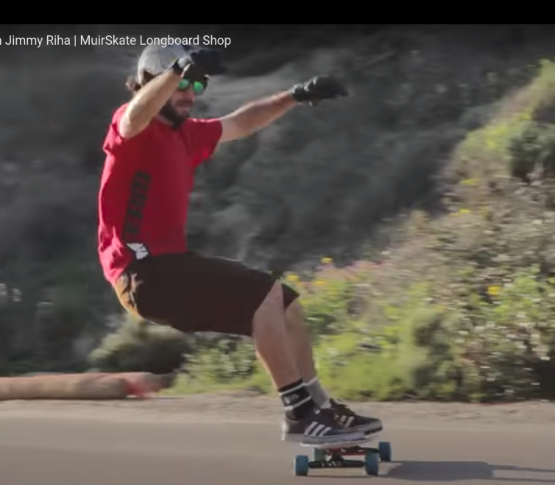
Examples – Standing Slide (facing Downhill)
Both Hands up to shoulder to counter balance of your lower body doing the turning.
Maintain upper body ”Straight up” – important for weight on your hip.
Head, Eyes, and Shoulder all facing the direction of your ‘intended’ traveling.
Sitting on the “Imaginary Chair” while facing downhill.
Both feet “in parallel” to the ground to maintain sliding straight and to avoid “turning”.

Slide 10
Standing Slide (facing uphill) – Stopping
Rear foot
4.) Your body momentum direction
Front foot
50/50% body weight on both feet.
Your
Intended Traveling Direction
Rear foot
Front foot
80% body weight on the Front foot.
Front foot
Rear foot
3.) Your board will (trust the Law of Physics!) automatically start sliding
2.) Rear foot pushes out a bit to generate the initiation of the sliding.
1.) Pre-slide turning

Slide 11
Standing Slide (facing uphill) – Turning
4.) Your body momentum direction
50/50% body weight on both feet.
Your
Intended Turning Direction
Rear foot
Front foot
80% body weight on the Front foot.
Front foot
Rear foot
3.) Your board will (trust the Law of Physics!) automatically start sliding
2.) Rear foot pushes out a bit to generate the initiation of the sliding.
1.) Pre-slide turning

Slide 12
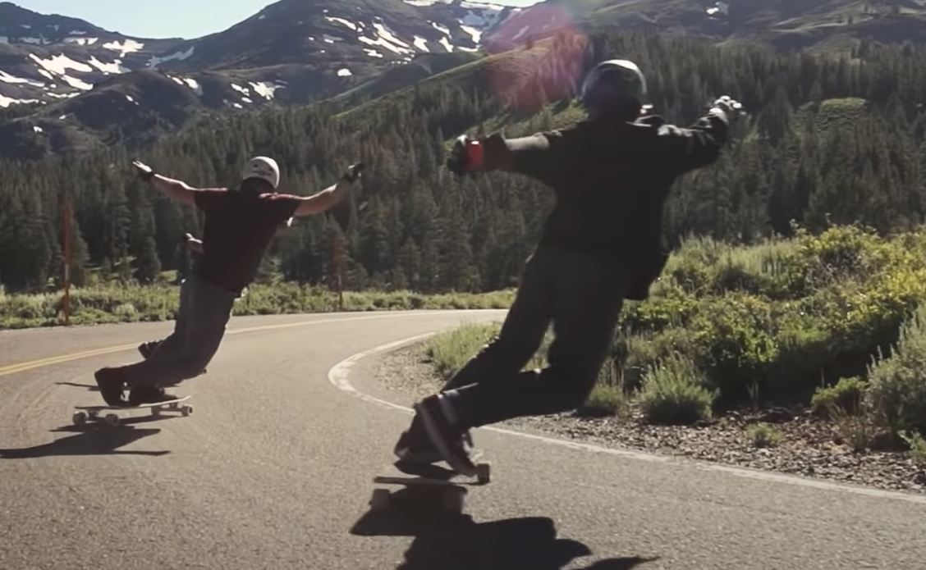

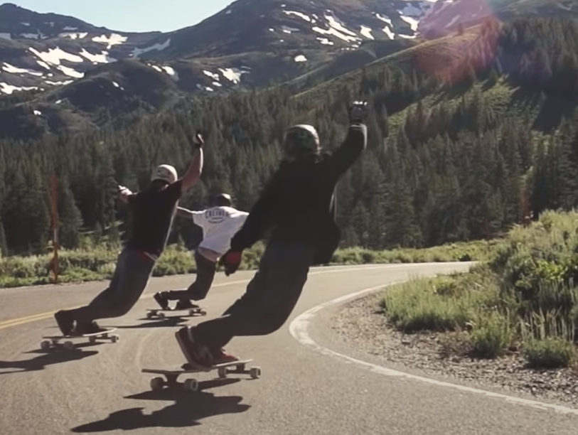

Slide 13
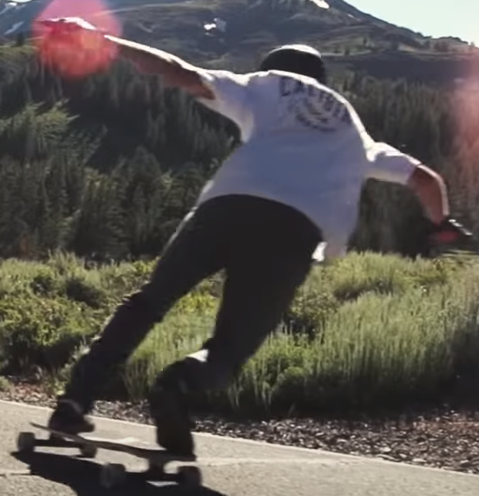
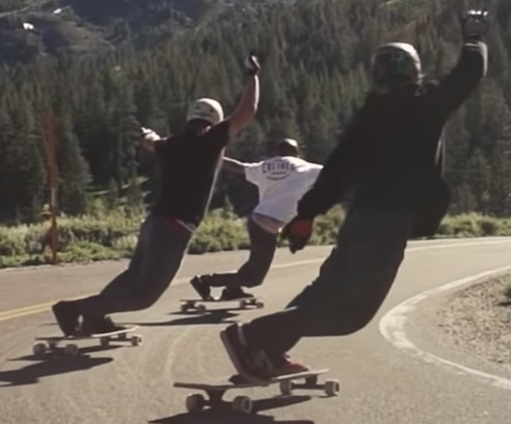

Slide 14
Racing Style Downhill Techniques

Slide 15
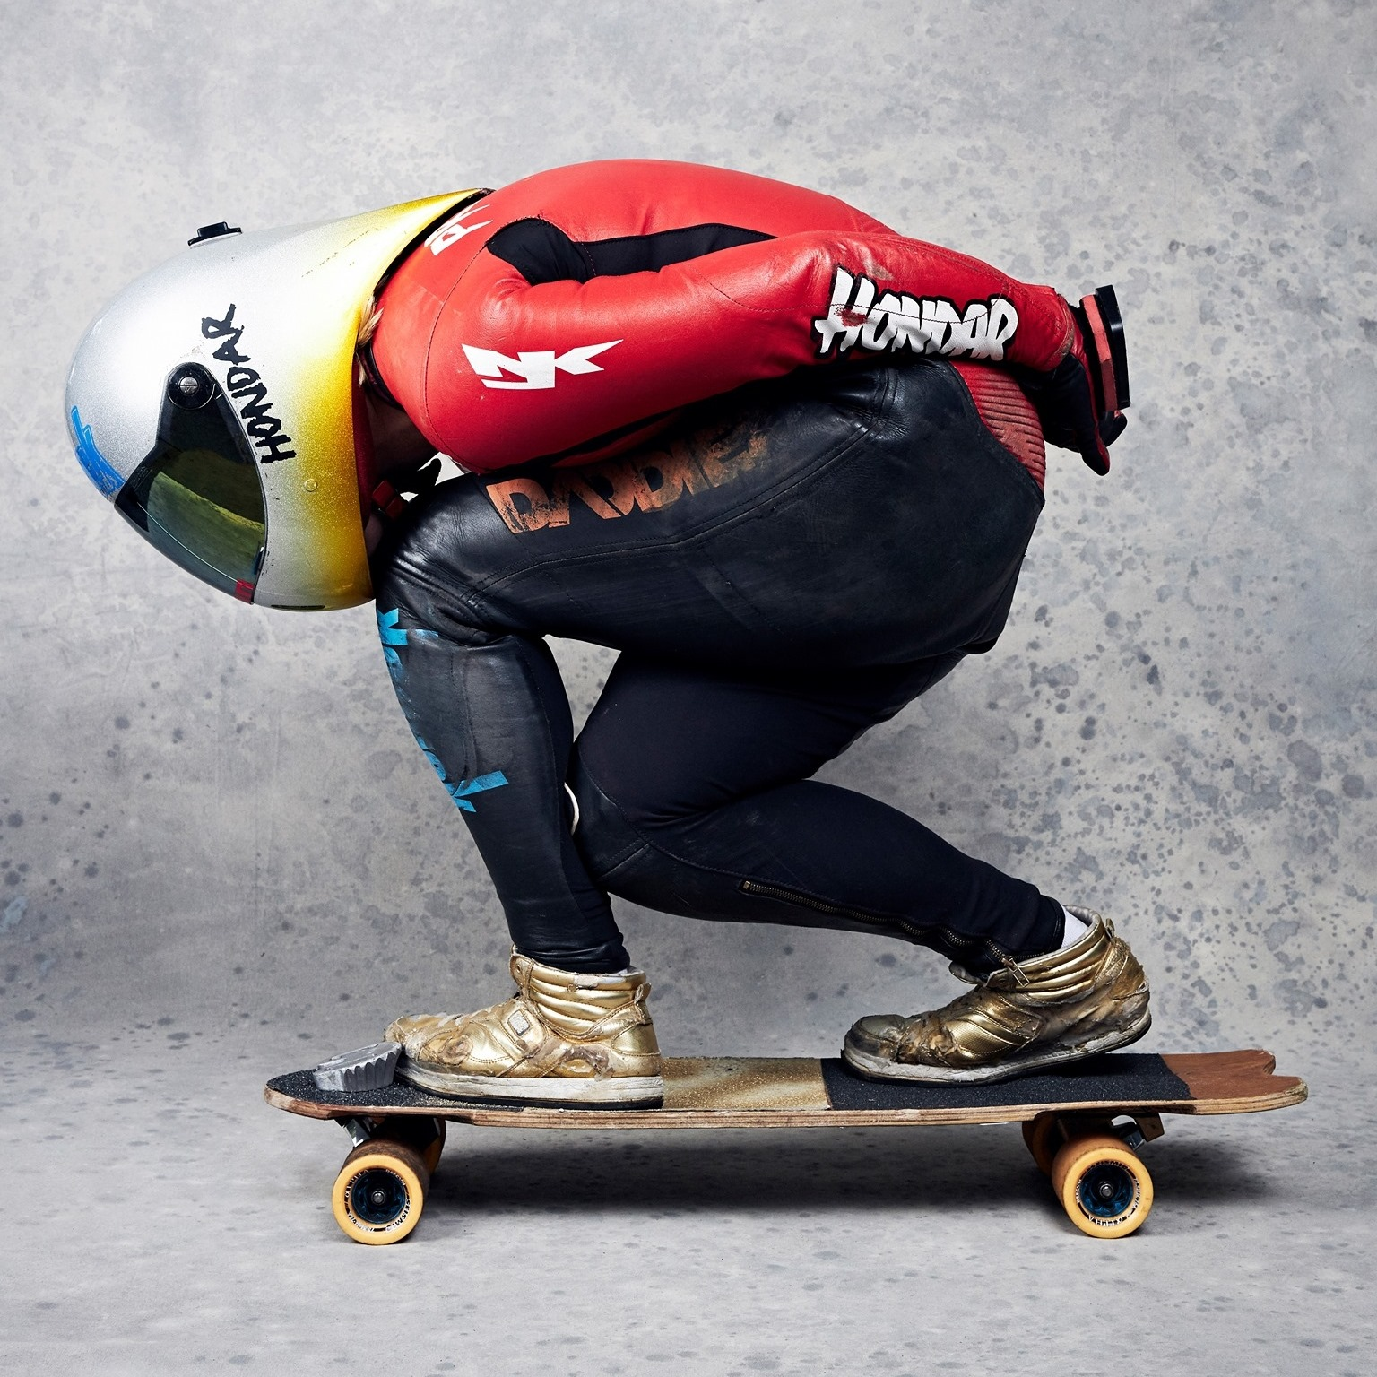
Downhill Racing - Postures
Weight distribution: More weight on the Front than the Rear feet.
Body Postures
Fully squatting-down style
Concept
The lower of your body’s ‘Center-of-Gravity (C.O.G.)’, the more stable while forwarding and turning.
More weight in the front to create more stable forward speed.
You need to “FULLY Squatting down” your body when racing downhill or free-ride higher turning stability – You minimize the height of your “C.O.G.” and more stability.
Height of Center of Gravity
Picture from Emily Pross Facebook: https://www.facebook.com/emilylongboards/

Slide 16
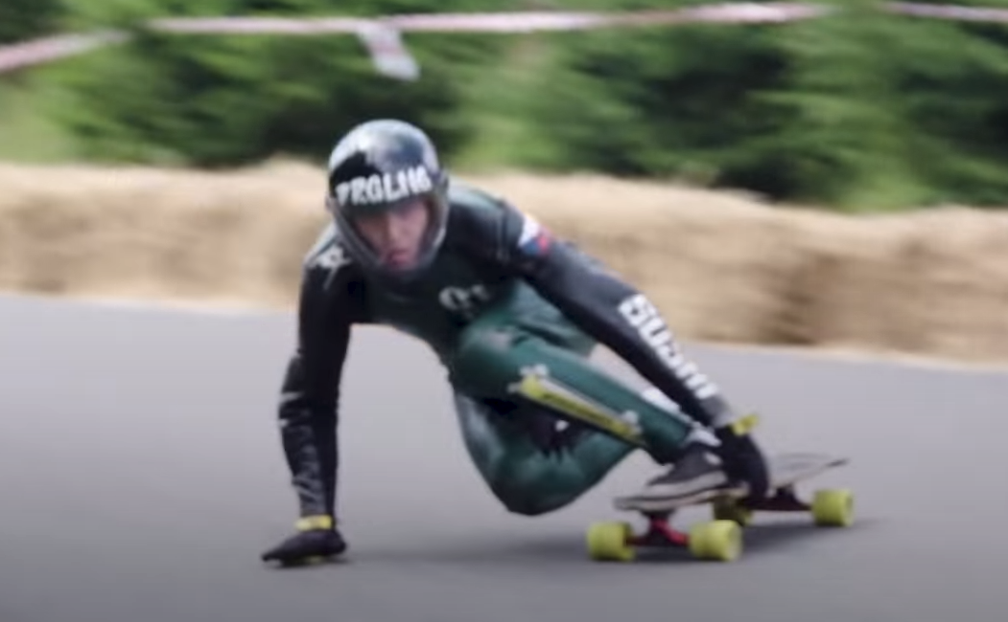
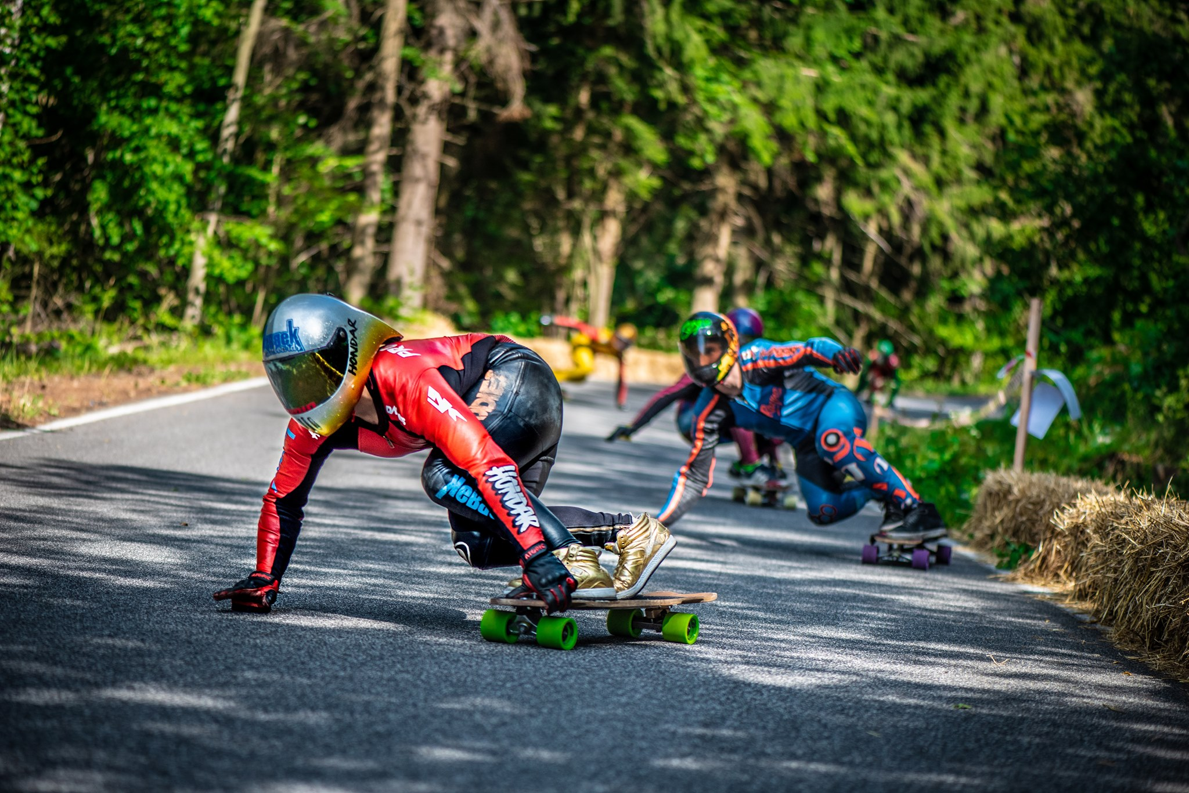
Downhill Racing – Turning Styles
Two styles of Downhill Racing
No-Palm Down Style
Using upper body to control the turns only
Palm Down Style
Using Palm (one only!) to assist the turns besides using body.
Further, there are two sub-style for “fore-hand” and “back-end” depending your stance style (goofy feet or not)
Pictures:
From Kozakov Challenge 2018
from Emily Pross Facebook page

Slide 17
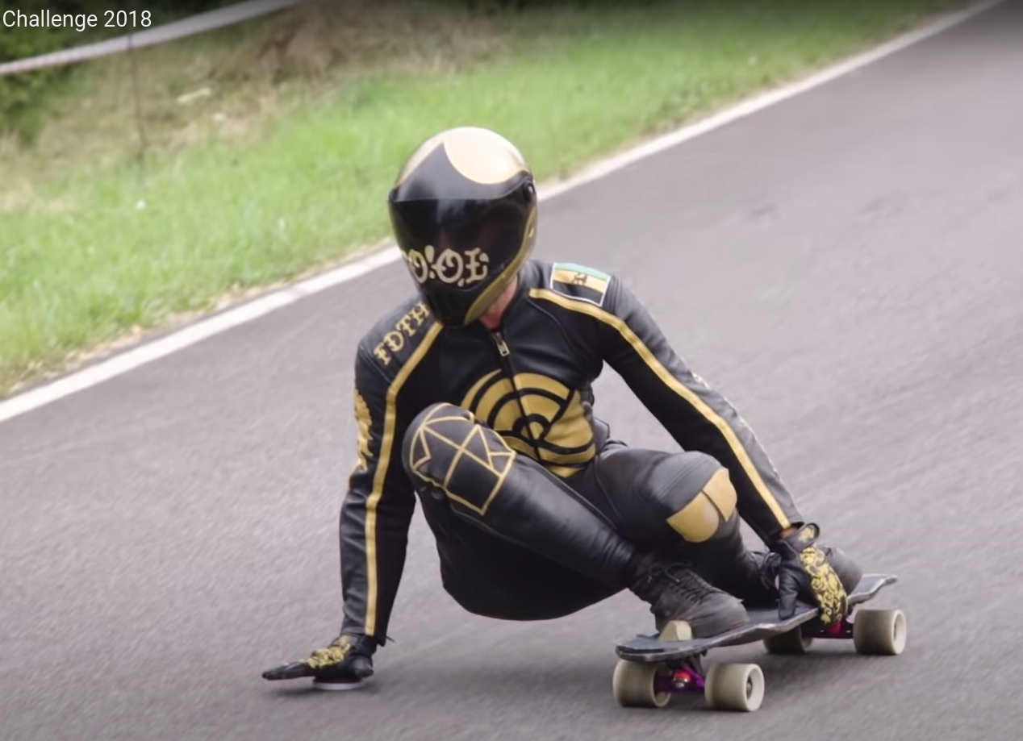
Downhill Racing Forehand vs. Backhand Palm-assisted Turning
As you can see, both forehand and backhand styles are turning right. However, backhand turning (the left picture) has the ‘lower Center-of-Gravity’ (sitting position) and hence can achieve much sharper turn but trimming speed. While the right picture (Emily) creates create larger turning radius with maintaining higher speed in-and-out the corner faster.
Backhand Palm-Assisted Turning
Pictures:
From Kozakov Challenge 2018
from Emily Pross Facebook page
Forehand Palm-Assisted Turning
Height of Center of Gravity
Height of Center of Gravity

Slide 18
Downhill Racing Turning Anatomy
Forehand Palm-assisted Turning
Pictures:
From Emily Pross Facebook page
20% vs. 75% weight distribution between the palm and the front foot.
Rear foot on the ’Edge’ as rudder to control direction
Head, Eyes, and Shoulder all facing the direction of your ‘intended’ traveling.
Forehand’s Palm in-parallel to ground and fingers up and pointing to your ‘intended’ traveling direction.
Height of Center of Gravity
The other hand: minorly adjusting the direction of board to prevent sliding outward. (Don’t pull up!)

Slide 19
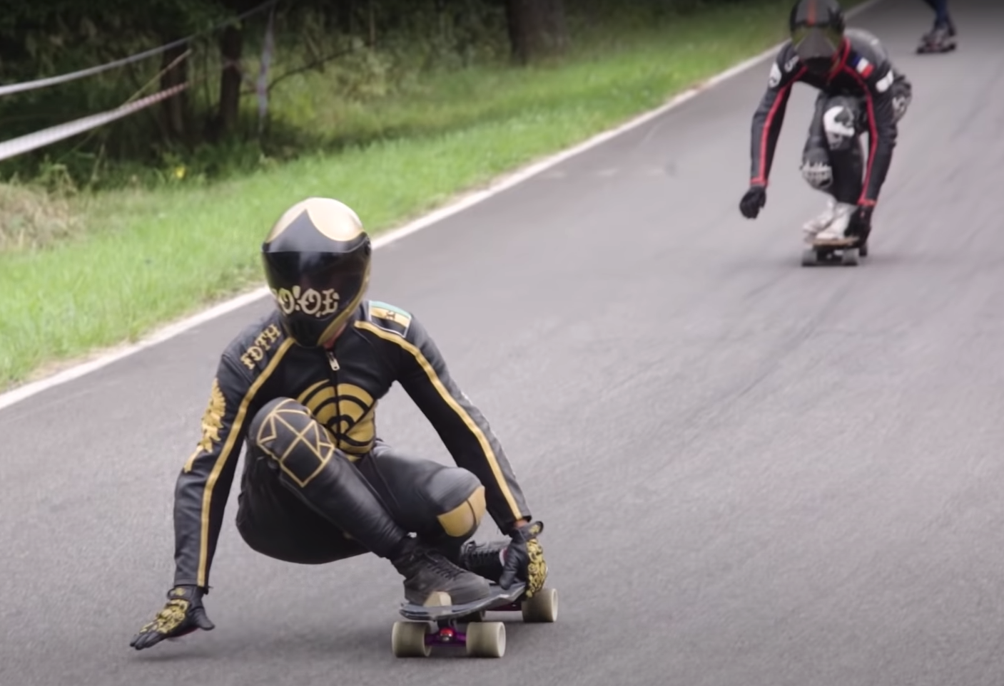
Racing Style: Backhand Palm-assisted Turning
Pictures:
From Kozakov Challenge 2018
Time sequence

Slide 20
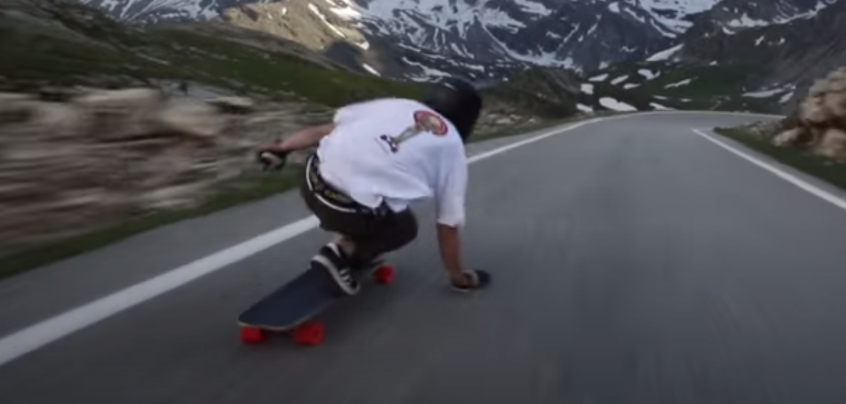
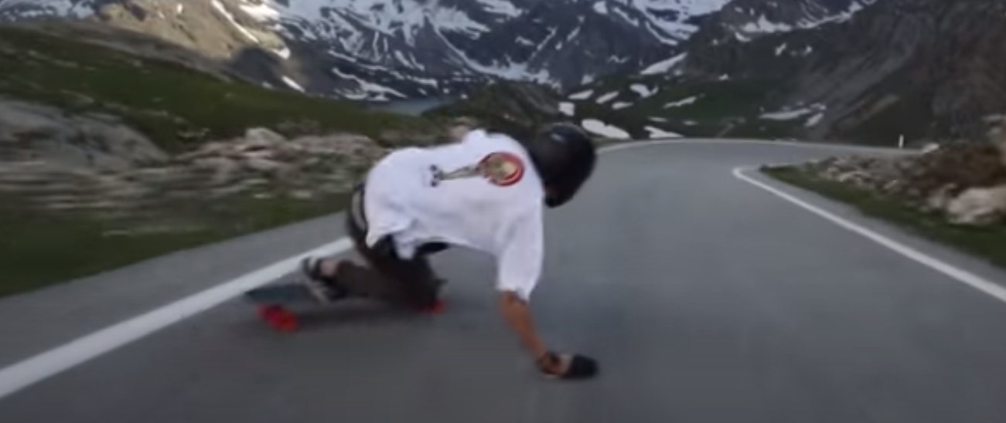
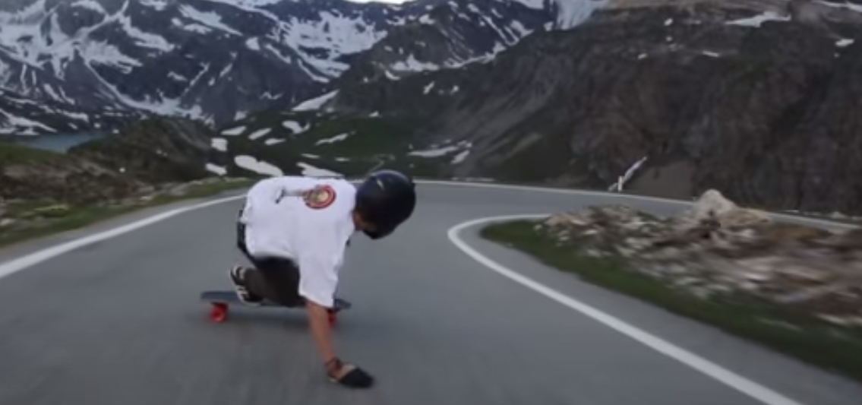
Racing Style: Forehand Palm-assisted Turning
Approaching corner – Palm down the side you want to turn
Josh Neuman
Rear foot ‘kick’ out a bit
3. Eyes LOOKing at the direction of traveling while dragging your sliding glove
Head, Eyes, and Shoulder all facing the direction of your ‘intended’ traveling.
Time sequence
Pictures from: Josh Newman Youtube

Slide 21
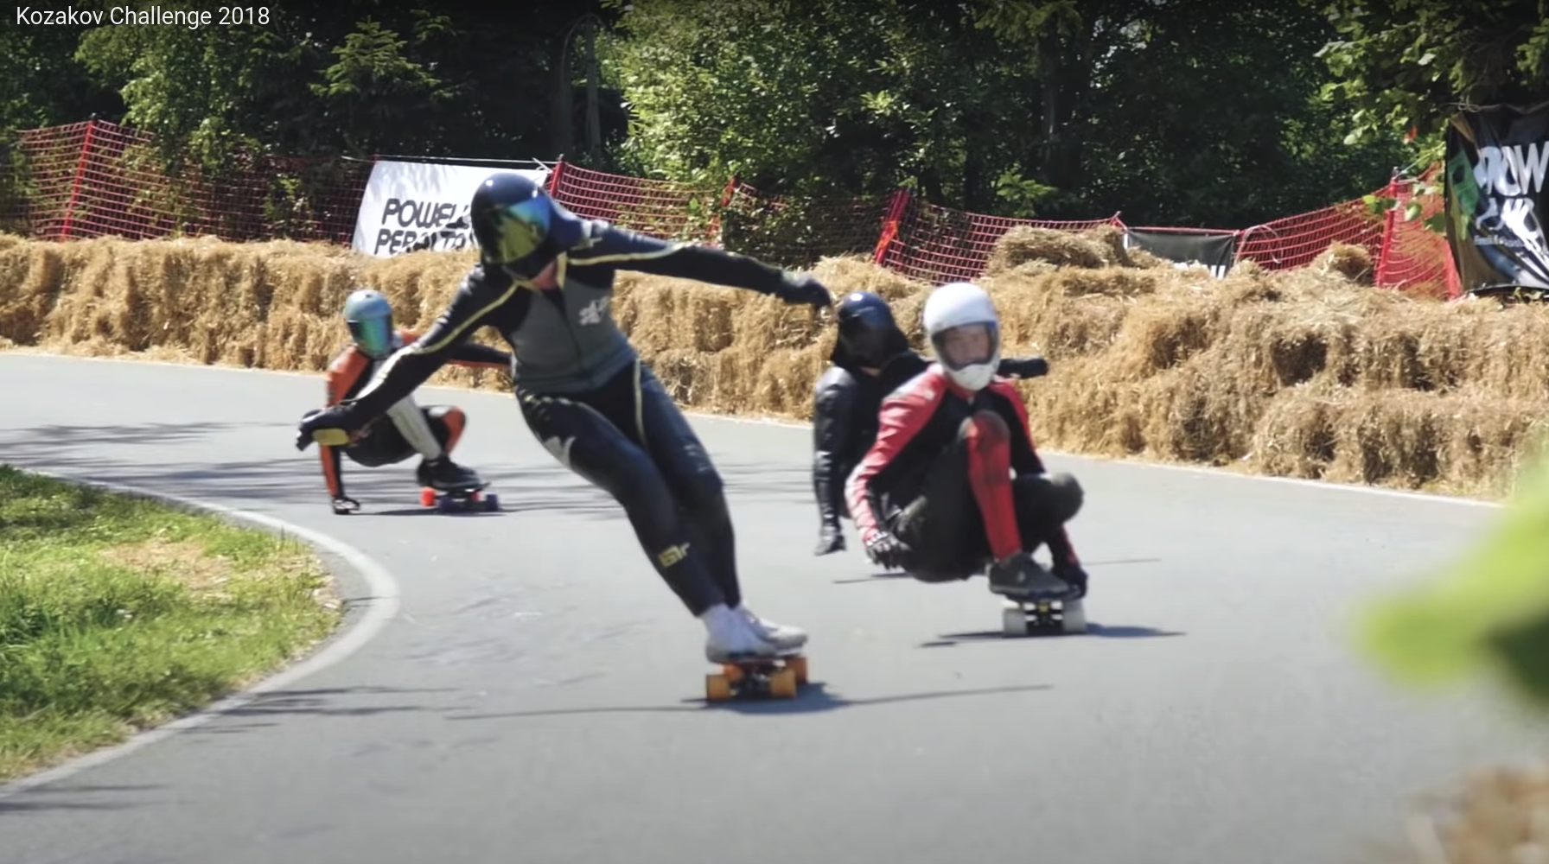
For Downhill Racing, Standing-turning style is mostly not common. Most downhill racers use squat-down to push the center-of-gravity to its lowest to achieve maximum turning-stability.
Pictures:
From Kozakov Challenge 2018

